Slide 1
Object-Oriented Software Engineering
Practical Software Development using UML and Java
Chapter 5:
Modelling with Classes

Slide 2
History of OCL
• Developed at IBM in 1995 originally as a business engineering language.
• Part of the official OMG standard for UML
• Current version is OCL 2.0.
• Formal language for the definition of constraints and queries on UML models.
Chapter 5: Modelling with classes

Slide 3
OCL statements
OCL statements can be built from:
  References to role names, association names, attributes and the results of operations
  The logical values true and false
  Logical operators such as and, or, =, >, < or <> (not equals)
  String values such as: ‘a string’
  Integers and real numbers
  Arithmetic operations *, /, +, -
Chapter 5: Modelling with classes

Slide 4
Invariant
Invariant Definition – An invariant is a constraint that should be true for an object during its complete lifetime.
Syntax
context <classifier>
inv [<constraint name>]: <Boolean OCL expression>
Chapter 5: Modelling with classes

Slide 5
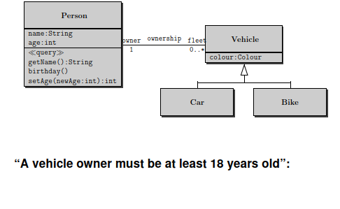
Example
context Vehicle
inv: self. owner. age >=18
Chapter 5: Modelling with classes

Slide 6
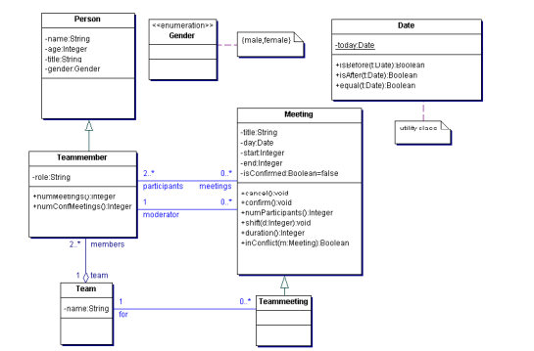
Example
Chapter 5: Modelling with classes

Slide 7
Invariant - Examples
context Meeting
inv: self.end > self.start
Equivalent Formulations
context Meeting
inv: end > start
-- "self" always refers to the object identifier from which the constraint is evaluated.
context Meeting
inv startEndConstraint: self.end > self.start
-- Names can be given to the constraint
Chapter 5: Modelling with classes

Slide 8
Precondition /Postcondition
• Constraint that specify the applicability and effect of an operation without stating an algorithm or implementation
• Are attached to an operation in a class diagram
• Allow a more complete specification of a system
Chapter 5: Modelling with classes

Slide 9
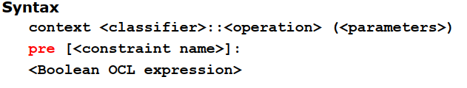
Precondition
Definition
– Constraint that must be true just prior to the execution of an operation
Chapter 5: Modelling with classes

Slide 10
Precondition – Examples
context Meeting::shift(d:Integer)
pre: self.isConfirmed = false
Chapter 5: Modelling with classes

Slide 11
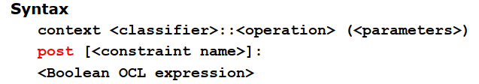
Post Condition
Definition
– Constraints that must be true just after to the execution of an operation
Chapter 5: Modelling with classes

Slide 12
Postcondition - Examples
context Meeting::confirm()
post: self.isConfirmed = true
Chapter 5: Modelling with classes

Slide 13
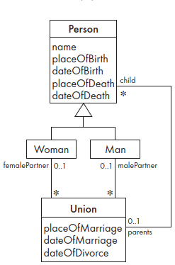
Exercise
Write OCL constraints expressing the following facts about Figure
You cannot die before you are born.
Chapter 5: Modelling with classes

